Slide 1
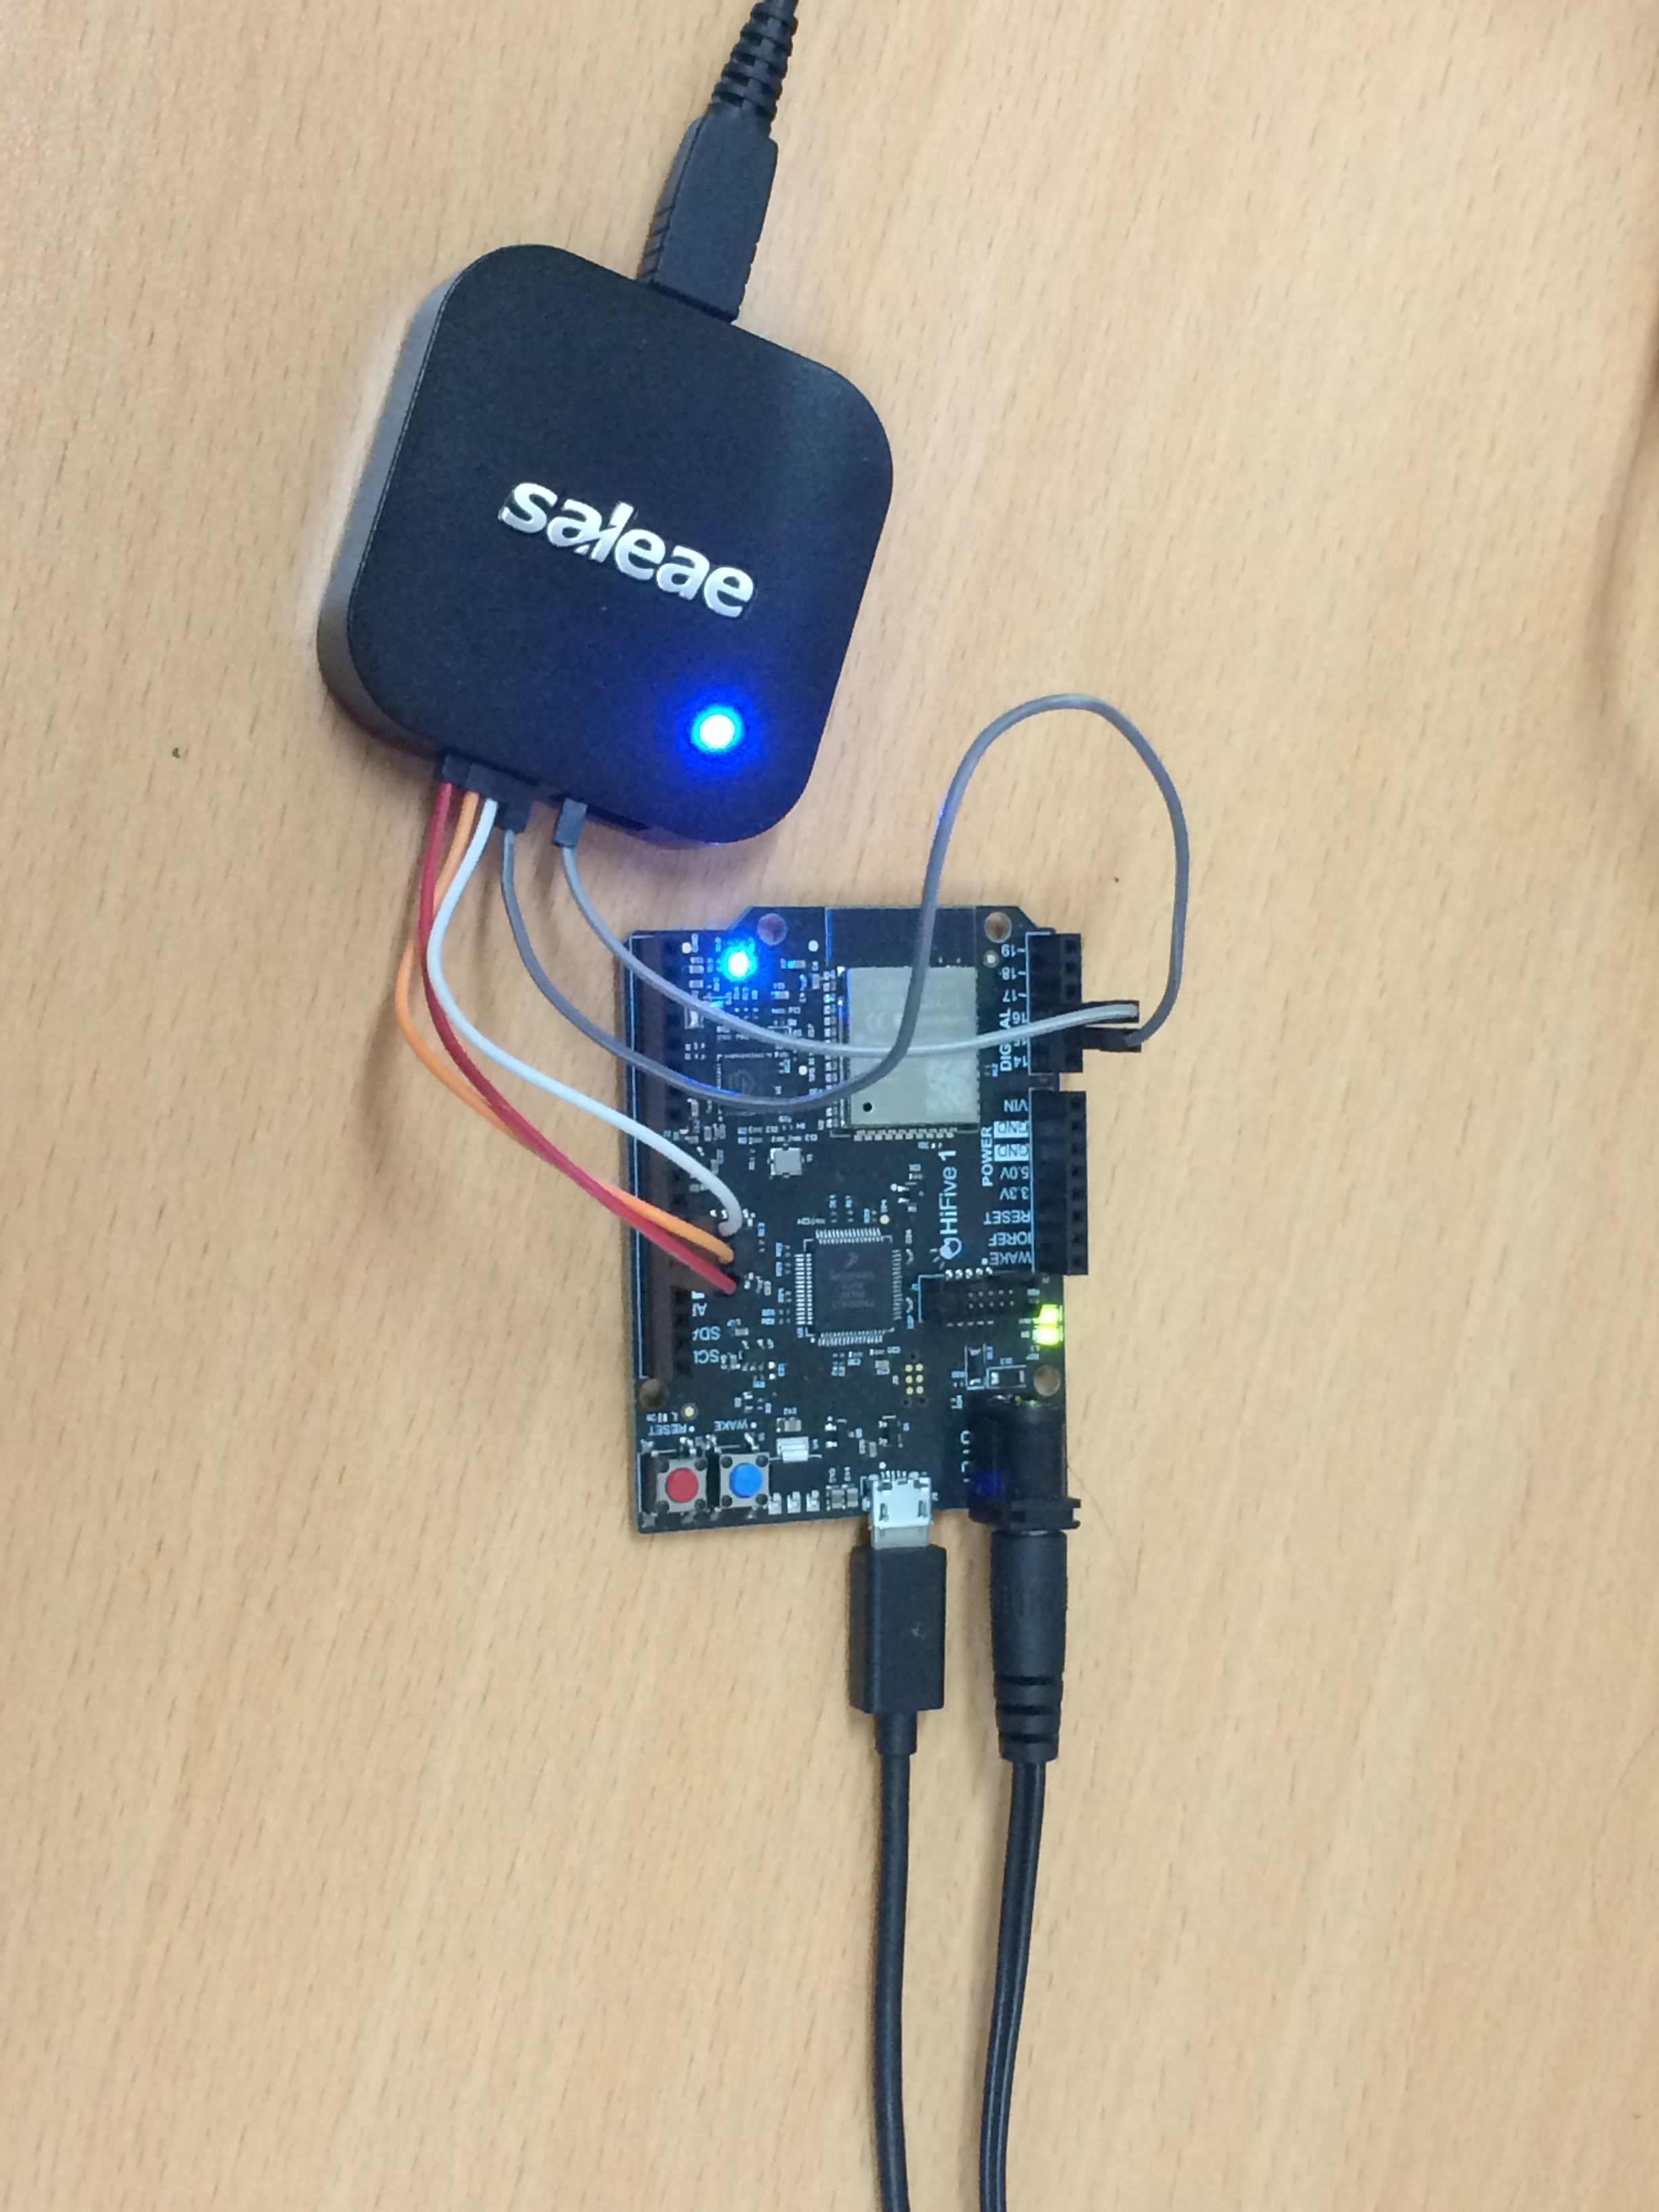
How to build HiFive1 demo using Freefom Studio
Nov-11-2019

Slide 2
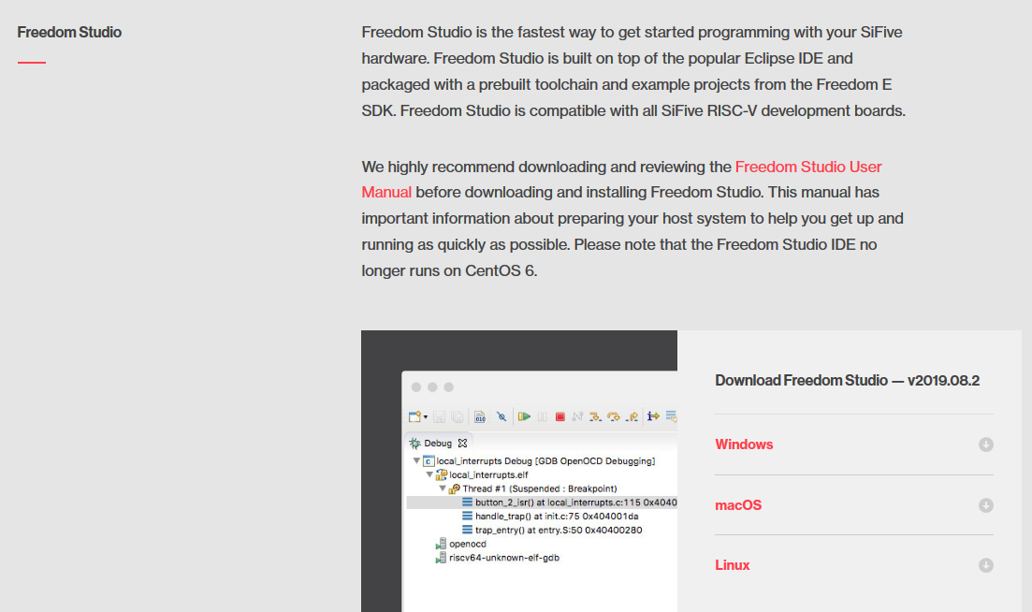
Freedom Studio
Go to https://www.sifive.com/boards
Download Freedom Studio and extract it
(This document use FreedomStudio-2019-08-1-win64.zip)

Slide 3
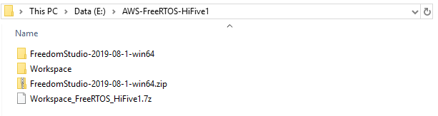
HiFive1 demo
Extract Workspace_FreeRTOS_HiFive1.7z

Slide 4
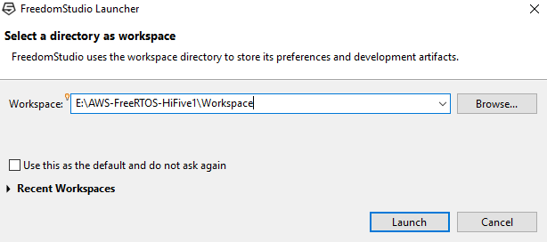
Build HiFive1 demo
Run FreedomStudio and navigate to Workspace

Slide 5
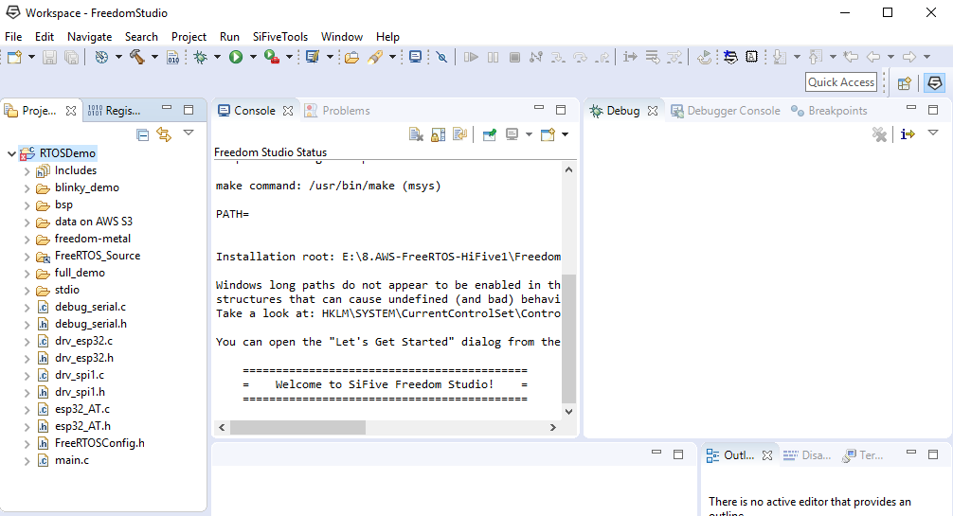
Build HiFive1 demo
Select RTOSDemo and build project

Slide 6
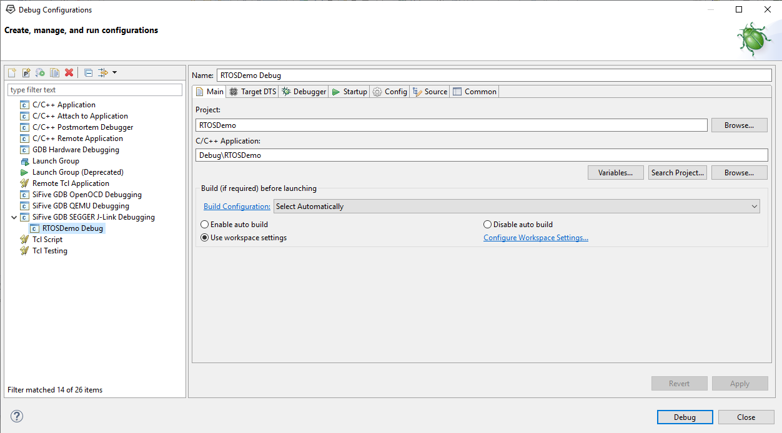
Download binaries to HiFive1
After building finished, connect HiFive1 board to your PC
Open Debug Configurations, select RTOSDemo Debug then click Debug

Slide 7
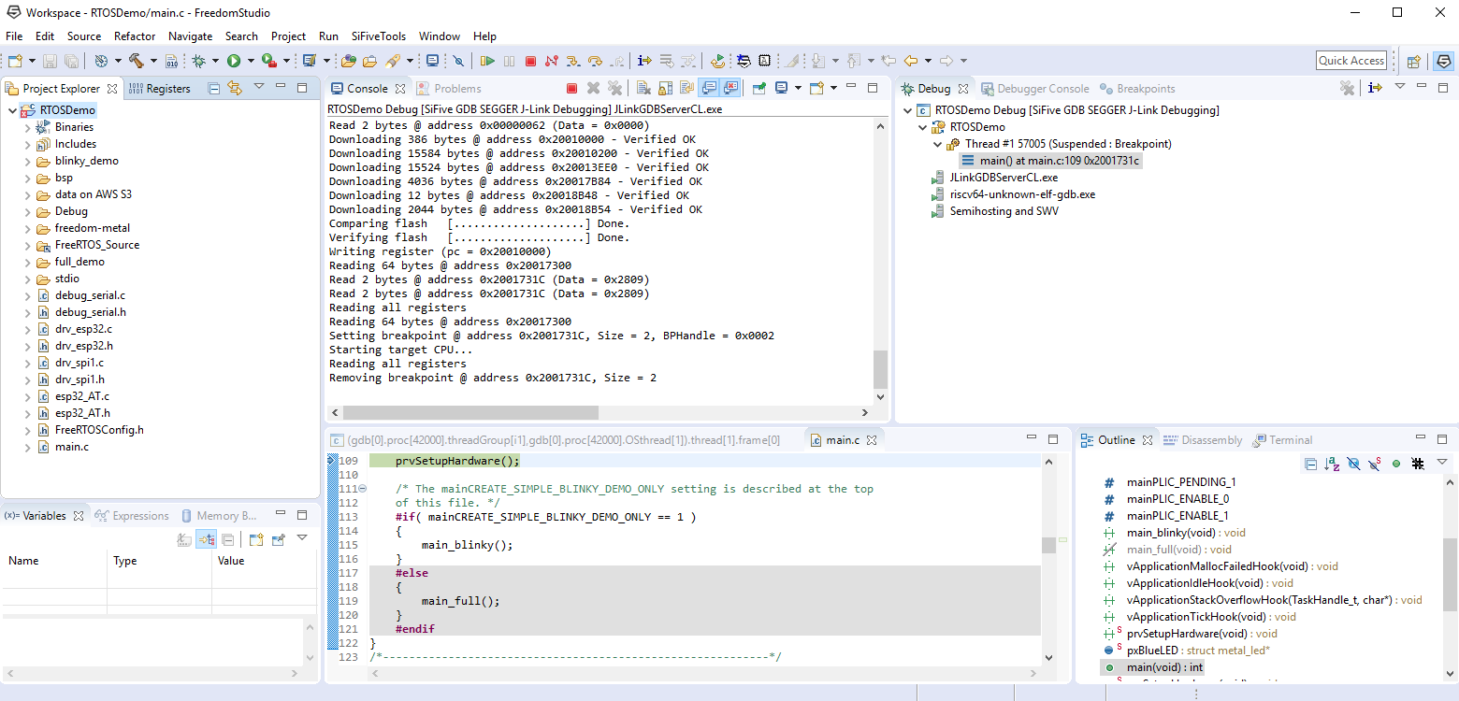
Run HiFive1 demo
Select Terminate to stop Debug
Press RESET button on HiFive1 board to run demo

Slide 8
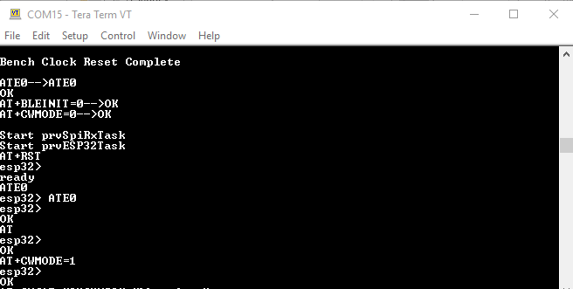
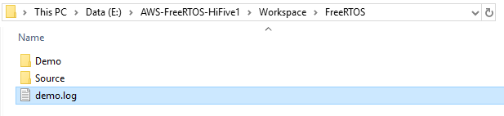
View print log
Use terminal as TeraTerm (baud rate = 115200) to see log
You can compare to normal case in the demo.log file

